Slide 1


DESIGN AND DEVELOPMENT OF PUF FOR HARDWARE SECURITY UPDATE
DEPARTMENT OF ELECTRONICS ENGINEERING
MIT CAMPUS, ANNA UNIVERSITY
BATCH : 2022-2026
Presented by:
Navabharathi T (2022504526)
Dharshan R (2022504517)
Lakshmanan S (2022504310)
Guided by:
Dr. V. R. Vijaykumar,
Professor,
Department of Electronics Engineering,
Madras Institute of Technology,
Anna University.

Slide 2
CONTENTS
Motivation
Objective
Introduction
Literature Survey
Block Diagram
Types of PUF
Work Progress
PUF Metrics
References

Slide 3
MOTIVATION
Modern hardware devices like smart cards, IoT devices, and medical instruments are increasingly targeted by reverse engineering, cloning, and side-channel attacks, posing serious threats to device identity and digital trust.
In 2023, a global investigation revealed over 1 billion counterfeit electronic components infiltrating critical sectors such as military, automotive, and healthcare. These fake chips endangered national security, as they could be maliciously modified or fail during operation.
Though there are traditional hardware security methods, like fuses or non-volatile memory (NVM) for key storage, they are vulnerable to physical attacks. Once the memory is read or duplicated, the entire system is compromised.
Physically Unclonable Functions (PUFs) offer a novel, low-power, and tamper-evident solution by leveraging random manufacturing variations in silicon. This enables unique, unclonable hardware IDs, removing the need to store sensitive keys—making it ideal for lightweight, embedded security systems.

Slide 4
OBJECTIVE
To develop a robust Arbiter PUF using Verilog HDL.
To analyze the uniqueness of the Arbiter PUF by generating responses to multiple challenges and comparing the responses across different PUF instances.
To evaluate various PUF metrices such as Inter-chip variation, Intra-chip variation, uniformity, reliability and bit-aliasing.
To implement the developed Arbiter PUF in FPGA platform, focusing on validating its functionality.

Slide 5
INTRODUCTION
A Physically Unclonable Function (PUF) is a hardware-specific security primitive designed to provide cryptographic functionalities such as secure key generation and device authentication, especially for embedded and IoT systems.
The physical structure of a PUF is simple to manufacture but extremely difficult or impossible to replicate, due to uncontrollable variations in the semiconductor fabrication process.While many systems use binary classification (real vs. fake), this approach can be limiting.
A PUF generates a unique output, known as a response, to a given input challenge, based on the intrinsic physical differences present in each Integrated Circuit (IC). These responses are used as digital fingerprints for secure and tamper-resistant identification

Slide 6
LITERATURE SURVEY
S.NO | AUTHOR | TITLE | JOURNAL DETAILS WITH YEAR | SIGNIFICANT CONTRIBUTION
1 | S. Hemavathy and V. S. Kanchana Bhaaskaran | “Arbiter PUF—A Review of Design, Composition, and Security Aspects ” | IEEE Access, vol. 11, pp. 33979–33993, 2023 | Inference: Provided a comprehensive review of Arbiter PUF designs, metrics, and their resilience against ML attacks. Many existing PUF architectures are still susceptible to deep learning and side-channel modeling.
2 | Sivappriya Manivannan, Rajat Subhra Chakraborty, Indrajit Chakrabarti, and Jothi Ramalingam | “Practical and Efficient PUF-Based Protocol for Authentication and Key Agreement in IoT” | IEEE Embedded Systems Letters, vol. 16, no. 2, pp. 118–121, 2024 | Inference: Proposed a lightweight authentication and key agreement protocol using Arbiter PUF, Fuzzy Extractor, and ECDH. Problem Identified: Conventional systems store large CRP sets or require pairing operations—both unsuitable for IoT.

Slide 7
LITERATURE SURVEY
S.NO | AUTHOR | TITLE | JOURNAL DETAILS WITH YEAR | SIGNIFICANT CONTRIBUTION
3 | Jim Plusquellic, Eirini Eleni Tsiropoulou, and Cyrus Minwalla | “Privacy-Preserving Authentication Protocols for IoT Devices Using the SiRF PUF” | IEEE Transactions on Emerging Topics in Computing, vol. 11, no. 4, pp. 918–931, 2023 | Inference: Developed COBRA and PARCE protocols using SiRF PUF that enhance privacy without leaking CRPs. Problem Identified: Conventional strong PUFs are vulnerable to model-building and response-leakage attacks.
4 | Fadi Farha, Huansheng Ning, Karim Ali, Liming Chen, and Christopher Nugent | “SRAM-PUF-Based Entities Authentication Scheme for Resource-Constrained IoT Devices | IEEE Internet of Things Journal, vol. 8, no. 7, pp. 5904–5914, 2021 | Inference: Proposed a lightweight SRAM-PUF authentication scheme suitable for low-power IoT devices. Problem Identified: SRAM-PUFs suffer from noise and entropy issues, especially under changing environmental conditions.

Slide 8
BLOCK DIAGRAM
Input Challenge (n-bit)
Challenge Register
Switch Network (Controlled by Challenge)
Delay Line Stages
Majority Voter (N_REP)
Arbiter (Time Comparator)
Signal Race Paths
Stable Output
(1-bit)

Slide 9
TYPES OF PUF
PUF maps the input challenge with a unique response, thus creating a challenge-response pair (CRP).
WEAK PUF:
Limited number of Challenge-Response pairs.
Used for cryptographic key generation.
STRONG PUF:
Large number of CRPs.
Used for authentication without using external cryptographic hardware.

Slide 10
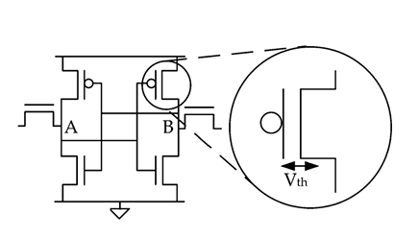
WEAK PUF
SRAM PUF (Memory based PUF)
Power-on state of SRAM cells generates unique Challenge-Response pair.
Other weak PUFs include Butterfly PUF, Ring-Oscillator PUF, etc.

Slide 11
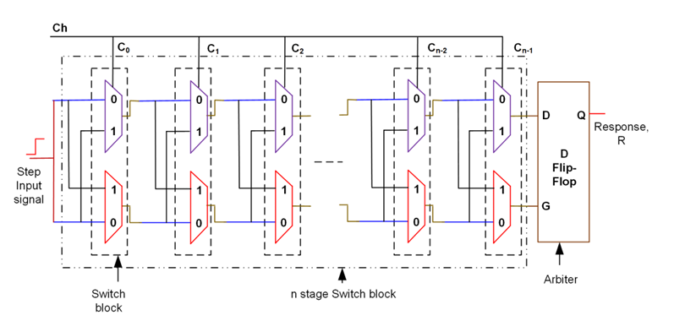
STRONG PUF
Arbiter PUF (Delay based PUF)
Uses manufacturing variability in gate delay as the source of unclonable randomness i.e. a race condition is established in a symmetric circuit.
Other strong PUFs include Optical PUF, Feed-Forward Arbiter PUF, etc.
FIRST REVIEW
11

Slide 12
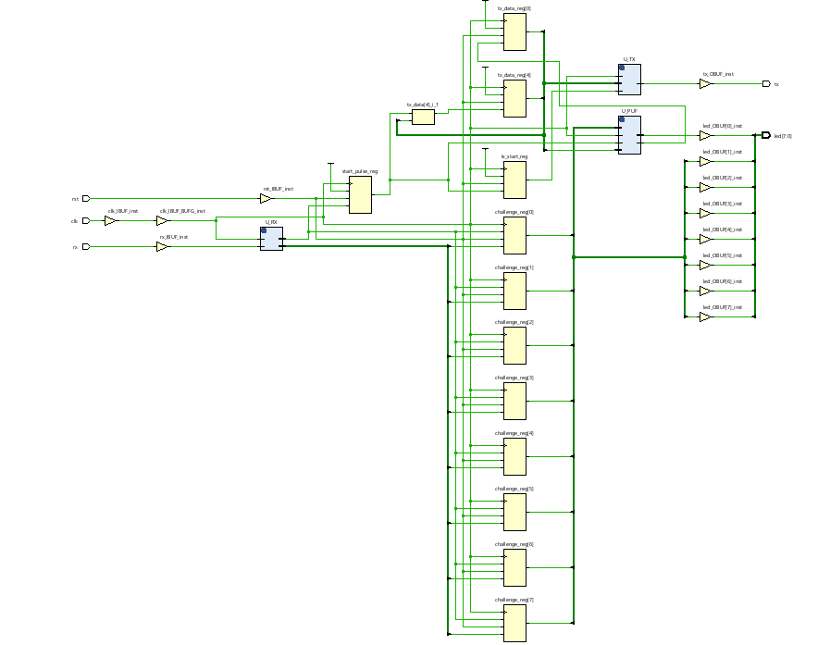
WORK PROGRESS

Slide 13
INTEGRATING UART INTO PUF PROJECT
What is UART?
  Universal Asynchronous Receiver/Transmitter (simple serial communication).
  Uses only TX (Transmit) & RX (Receive) lines.
  Communicates between FPGA and PC via USB.
Why Add UART to PUF?
  Automated Data Collection – Send all 256 PUF responses directly to PC for logging.
  Flexible Challenge Input – Enter challenges from PC without reprogramming FPGA.
  Faster Testing – Quickly gather CRPs from multiple boards.
  Live Demo Capability – Show challenge–response exchange in real time on terminal.
  Large-Scale Evaluation – Easily generate thousands of CRPs for statistical analysis.
Planned Setup:
  PC (Python/Terminal) ⇄ UART ⇄ Basys 3 FPGA (PUF Module)

Slide 14
UART INTEGRATION WITH THE PUF
  Integrated UART Module with PUF design for challenge–response communication.
  Supports receiving challenges from PC via UART RX.
  Generates PUF response for each challenge.
  Sends responses back to PC via UART TX for logging and analysis.
  Verified data flow between PC ↔ FPGA ↔ PUF in simulation.
  Ready for hardware testing with Basys 3 FPGA.

Slide 15
PUF METRICS
Binary | Response | Response | Response | Response | Response
00000000 | 0 | 1 | 1 | 1 | 1
00000001 | 0 | 0 | 0 | 0 | 0
00000010 | 0 | 0 | 0 | 0 | 0
00000011 | 0 | 0 | 0 | 0 | 0
00000100 | 0 | 0 | 0 | 0 | 0
00000101 | 0 | 0 | 0 | 0 | 0
00000110 | 0 | 0 | 0 | 0 | 0
00000111 | 0 | 0 | 0 | 0 | 0
00001000 | 0 | 0 | 0 | 0 | 0
00001001 | 0 | 0 | 0 | 0 | 0
00001010 | 0 | 0 | 0 | 0 | 0
00001011 | 0 | 0 | 0 | 0 | 0
00001100 | 0 | 0 | 0 | 0 | 0
00001101 | 0 | 0 | 0 | 0 | 0
00001110 | 0 | 0 | 0 | 0 | 0
00001111 | 0 | 0 | 0 | 0 | 0

Slide 16
PUF METRICS
Total entries N = 256
Number of 1s N1 = 84
Number of 0s N0 = 172
Now, the percentage of each:
Percentage of 1s = (N1 / N) × 100 = (84 / 256) × 100 ≈ 32.81%
Percentage of 0s = (N0 / N) × 100 = (172 / 256) × 100 ≈ 67.19%
Answer:
1s = 32.81%
0s = 67.19%
This confirms that the output is biased toward 0s.
Ideal PUF randomness: The responses should be randomly distributed, ideally 50% 1s and 50% 0s.

Slide 17
PUF METRICS
FPGA responses: 255 out of 256 match the reference
Stability Formula:
Stability (%) = (Number of matching responses / Total responses) × 100
Step-by-Step Calculation:
Stability (%) = 255 / 256 × 100
255 ÷ 256 = 0.99609375
0.99609375 × 100 ≈ 99.61%
Result:
Stability = 99.61%
Interpretation:
The PUF is extremely stable
Only 1 response out of 256 flips

Slide 18
WORK FLOW
Review | Work to be Done
Review 1 | Implemented 8-bit Arbiter PUF in Verilog and verified functionality in Vivado with UART interface.
Review 2 | To collect Challenge-Response Pairs (CRPs) and calculated PUF metrics like uniqueness, reliability, and uniformity.
Review 3 | To improved PUF stability and metrics using XOR-based architecture and post-processing techniques.

Slide 19
REFERENCES
J.Plusquellic and M.Areno,“Correlation-based robust authentication(cobra) using helper data only,” Cryptography, vol. 2, no. 3, 2018, Art. no. 21. [Online]. Available: https://www.mdpi.com/2410--387X/2/3/21
D.Heeger and J. Plusquellic, “Analysis of IoT authentication over LoRa,” in Proc. IEEE 16th Int. Conf. Distrib. Comput. Sensor Syst., 2020, pp. 458–465.
J.Plusquellic, “Shift register, reconvergent-fanout (SiRF) PUF implementation on an FPGA,” Cryptography, vol. 6, no. 4, 2022, Art. no. 59. [Online]. Available: https://www.mdpi.com/2410--387X/6/4/59
U. Rührmair et al., “PUF modeling attacks on simulated and silicon data,” IEEE Trans. Inf. Forensics Security, vol. 8, no. 11, pp. 1876–1891, Nov. 2013.
G. T. Becker, “On the pitfalls of using Arbiter-PUFs as building blocks,” IEEE Trans. Comput.-Aided Design Integer. Circuits Syst., vol. 34, no. 8, pp. 1295–1307, Aug. 2015.

Slide 20
REFERENCES(Cntd.)
Y. Wen and Y. Lao, “Enhancing PUF reliability by machine learning,” in Proc. IEEE Int. Symp. Circuits Syst., 2017, pp. 1–4.
H.Awano, T.Iizuka and M.Ikeda “PUF Net :A deep neural network based modeling attack for physically unclonable function,” in Proc. IEEE Int. Symp. Circuits Syst., 2019, pp. 1–4.
Y. Xu, Y. Lao, W. Liu, Z. Zhang, X. You, and C. Zhang, “Mathematical modeling analysis of strong physical unclonable functions,” IEEE Trans. Comput.-Aided Design Integer. Circuits Syst., vol. 39, no. 12, pp. 4426–4438, Dec. 2020.
J. Delvaux, “Machine-learning attacks on PolyPUFs, OB-PUFs, RPUFs, LHS-PUFs and PUF-FSMs,”IEEETrans.Inf.Forensics Security, vol. 14, no. 8, pp. 2043–2058, Aug. 2019.
Y. Lao and K. K. Parhi, “Statistical analysis of MUX-based physical unclonablefunctions,”IEEETrans.Comput.-AidedDesignIntegr.Circuits Syst., vol. 33, no. 5, pp. 649–662, May 2014.

Slide 21
THANK YOU

